Slide 1
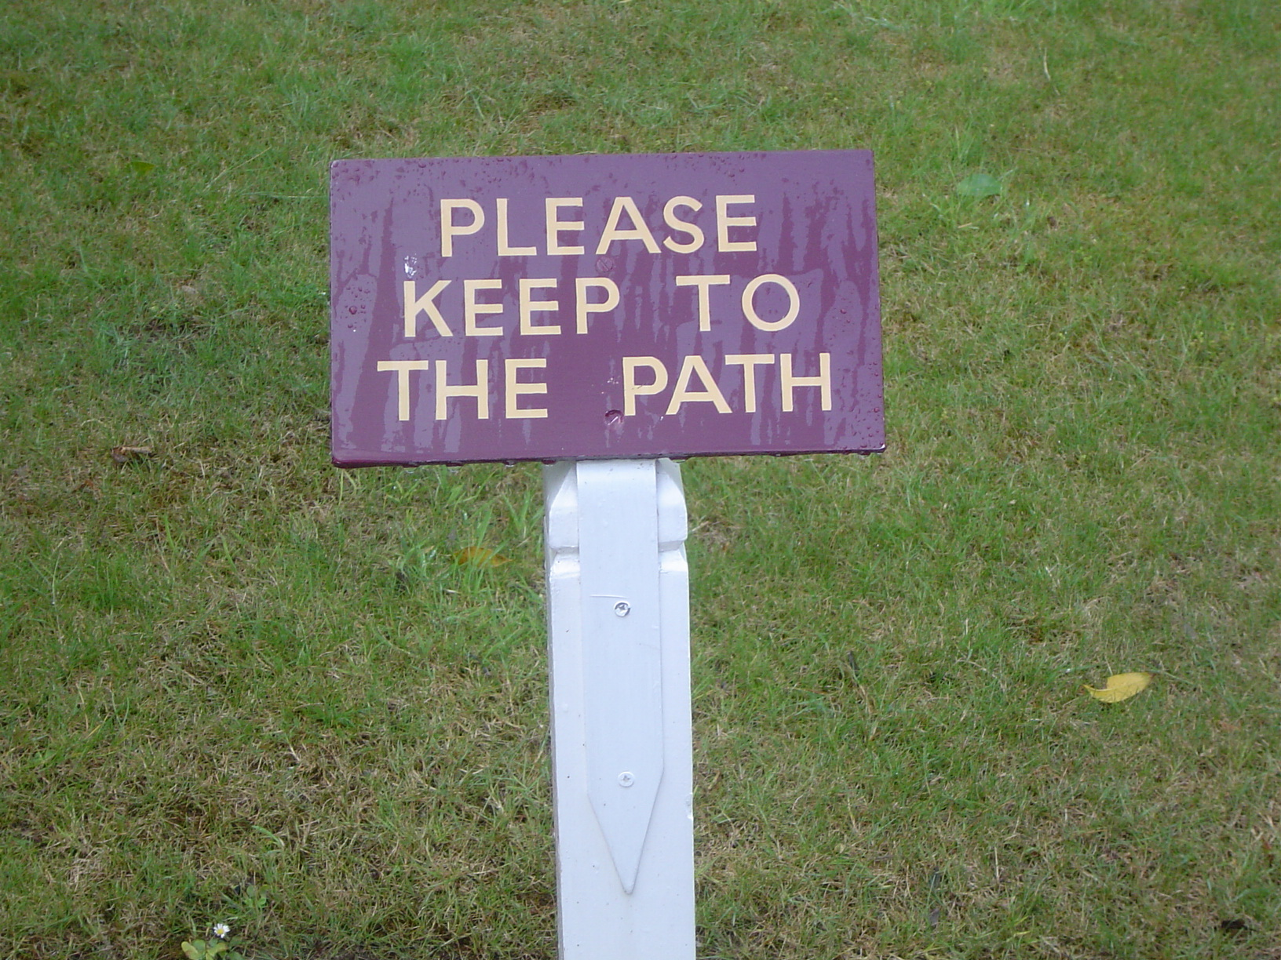
Interpretation

Slide 2
What do we understand by Interpretation?
Work in groups
Rank the statements about interpretation according to how much you agree with them

Slide 3
What is Interpretation?
Interpretation is primarily a communication process that helps people make sense of, and understand more about, your site, collection or event.
Association for Heritage Interpretation

Slide 4
What is Interpretation?
The chief aim of interpretation is not instruction, but provocation.
Any interpretation that does not somehow relate what is being displayed or described to something within the personality or experience of the visitor will be sterile.
Freeman Tilden

Slide 5
Planning for Interpretation
Planning
Why is interpretation needed?
Who is it for?
What are you going to interpret?
How are you going to do it?

Slide 6
Planning for Interpretation
Why are you doing this?
Understanding?
Management of site/visitors?
From: A Sense of Place.
An Interpretive Planning Handbook.
Editor: J. Carter
What will you interpret?
Think about:
Features, Unique stories
Accessibility, Themes
Who is it for?
Think about your visitors:
Number, characteristics,
Interests, time available
How will you do it?
Choice, location & timing of media?
Different themes for different places?
Your objectives?
How will it be managed?
Staffing? Skills? Maintenance?
Materials? Building? Funding?
Monitoring and Evaluation
Is it working? Does it achieve your aim?
How can you improve

Slide 7
Why are you doing it?
This is really important
It can be part of heritage management, tourism and community development (for example)
Define your aims at the start and agree on them
For example, visitor management aims may be about where your encourage people to go, at what time, and what services they will find there
Don’t forget there must be something of interest though!

Slide 8
Who are you doing it for?
In groups, think of possible groups coming to a site, and what they might want from that site. Think of at least 2 in your group
Remember most people are just there to enjoy themselves, not to learn
Think about:-
Who they are – children? Locals? Grandparents?
What they are expecting? All these will want something different.
What do they already know about your site?
How long will they stay?

Slide 9
What has my site got to offer?
General Features
Physical Features
Built environment & human activity
Flora and Fauna
Folklore
History
Here and Now
Fragility and Safety
What’s special or stands out?
Views, geology, accessibility?
Any interesting buildings? What have people done here?
Species, habitats, seasons?
Any old legends/myths?
Old maps, photos, drawings?
What’s happening now?
For visitors and the site

Slide 10
What has my site got to offer 2?
Your visitors
What do they want to know/do/see?
What will strike them on your site
What senses can you use?
What can they see that’s new to them?
What can they hear?
Get them to touch things – tree bark, soft moss, find something hard and cold…
Can you find something for them to smell?
What about eating something? If it’s safe of course!

Slide 11
How will you do it?
Theme: helps to organise your interpretation. For example: When people leave they will know that…
Objectives: SMART ones
Media: techniques you could use
Means: your budget and resources

Slide 12
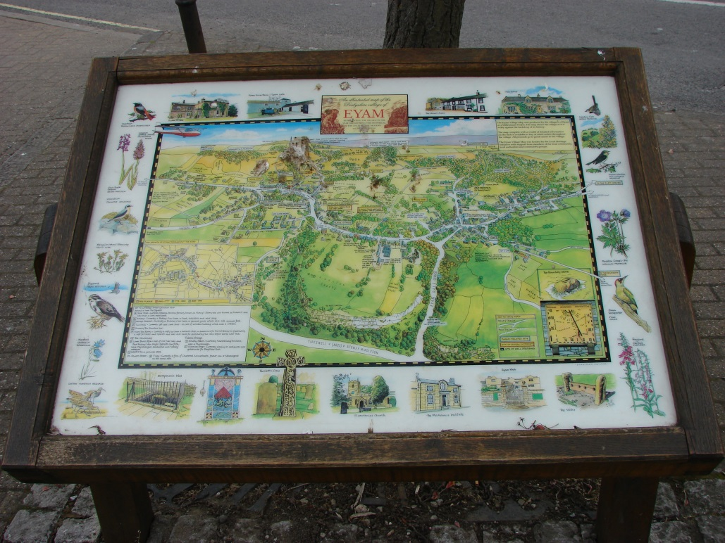
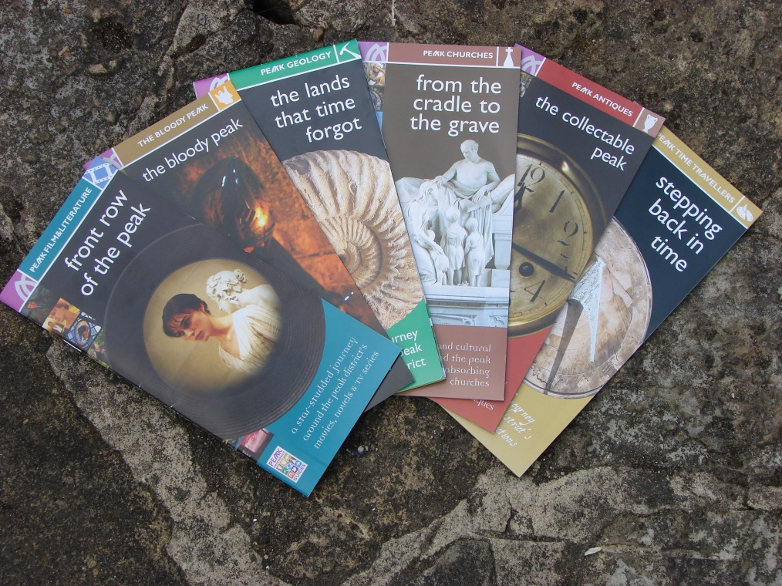
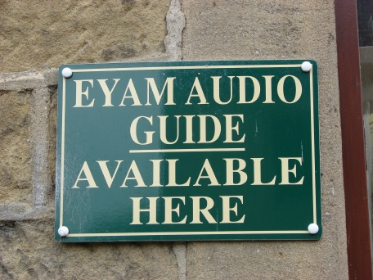
Interpretation Techniques
Work in groups
Make a note of all the interpretation techniques you can think of

Slide 13
Interpretation Techniques
Techniques
Which include:
Person to Person
Panels
Publications
Multi media
Art
Visitor Centres
Guided walks, talks, activities
Lectures, talks, demonstrations
Storytelling, performance theatre
Maps and information
Leaflets, posters, guidebooks
Audio Visual, Podcasts, PCs, Models
Sculpture, Structures, Music
Exhibitions, Display, Information, Museums

Slide 14
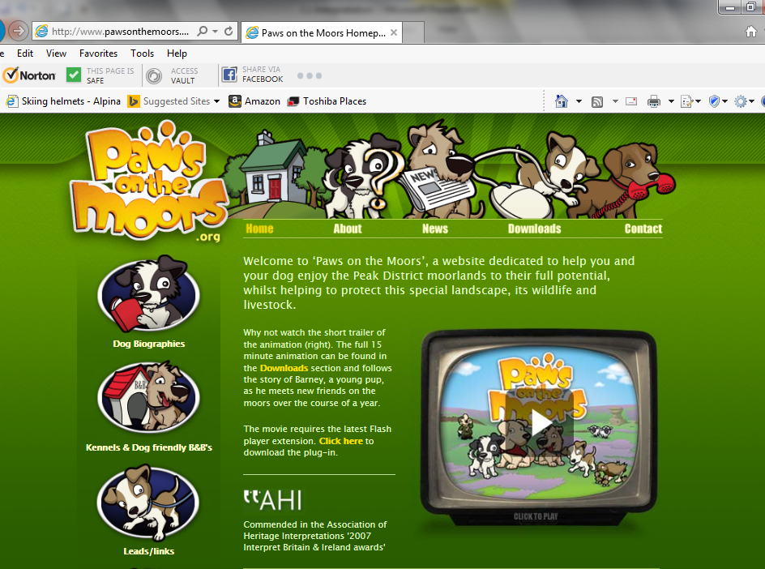

Slide 16
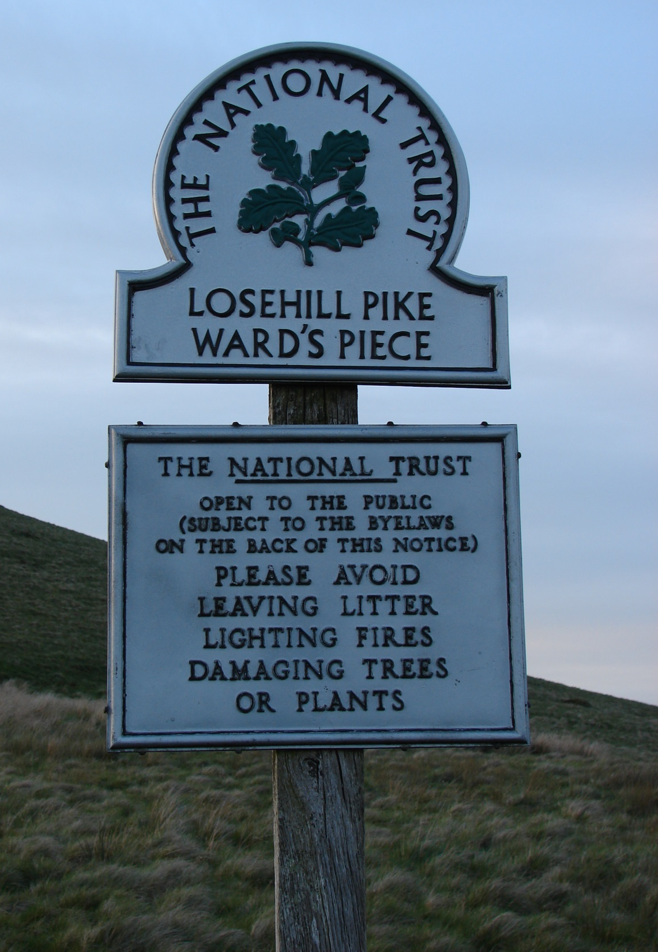
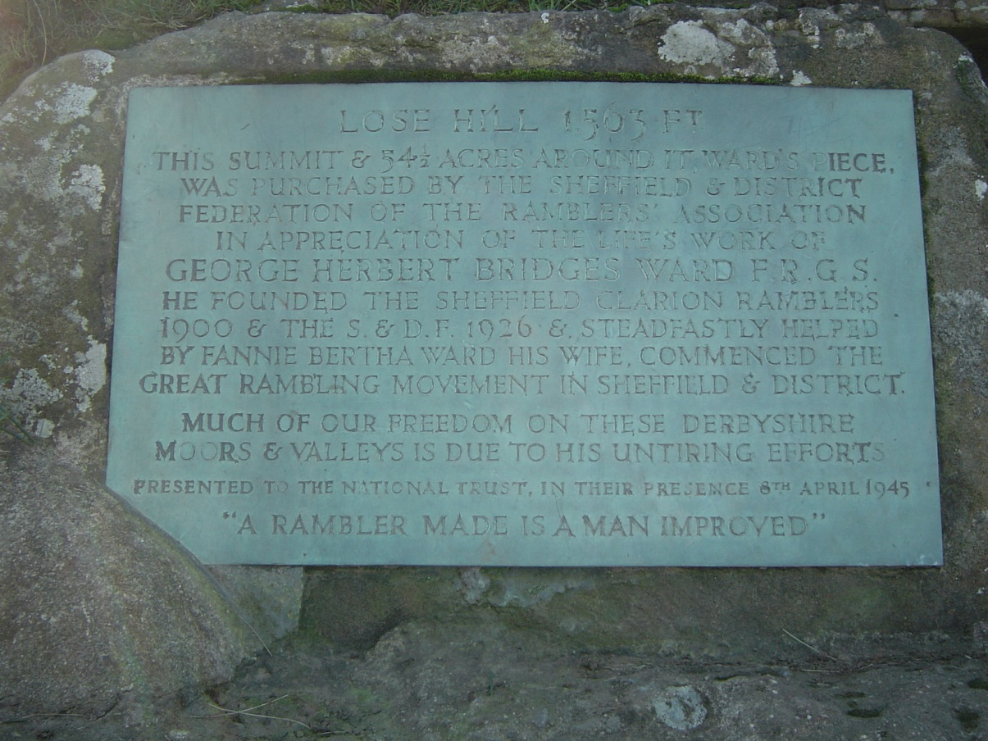

Slide 17
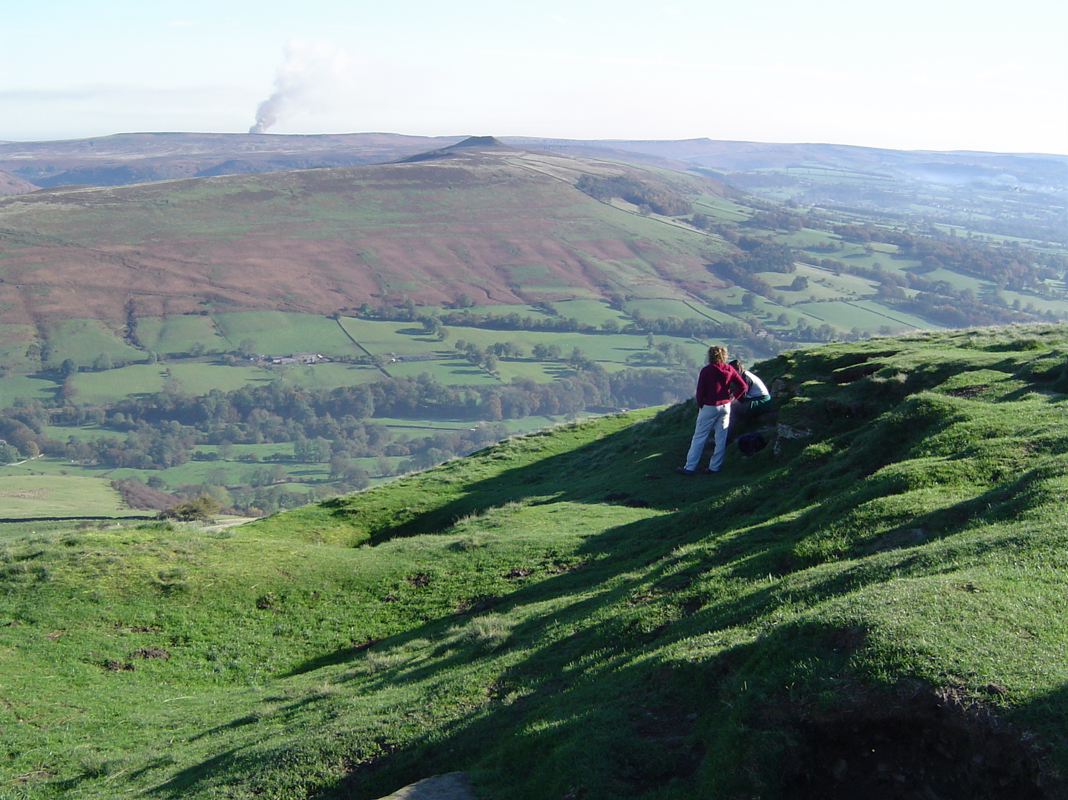

Slide 18
Planning for Interpretation
Do it!
Implement the project
Manage it
Is it sustainable?

Slide 19
Planning for Interpretation
Afterwards
Monitor
Evaluate
Were your objectives met?
How can you improve?

Slide 20
In summary
You need to plan carefully before launching into interpretation
Consider Why, Who, What and How
Not everything needs interpretation. A beautiful view may be best left as just a beautiful view!

Slide 21
Interpretation Site Visit
Each person will be assigned to a group. Each group will familiarise themselves with the site, gathering together available information about the potential and constraints of the site, existing facilities and visitor use. Each group will have the same resources available but will have a different target visitor group and a different theme or ‘take home’ message.
You are to produce
One or two example mock-ups to illustrate your ideas e.g. draft leaflet, panel, exhibition, multi-media presentation or guided walk outline
You should be prepared to present your ideas to the other groups at 16.45, but do not explicitly say what your theme or ‘take home’ message is. The other groups will comment on what they think it is, together with how appropriate they think your methods are for the site and target audience given.

Slide 22
Site Visit
Timings:
11.15 Finish session. Coffee break and prepare to depart
11.45 Depart for site.
12.15 Arrive on site. Explore and identify your interpretation. Packed lunch.
13.45 Leave site
14.15 Arrive at training venue. Return to training room.
Short session on presentation skills. Information to be used in delivering your talk about your interpretation.
14.45 Time to prepare
16.45 Presentation of interpretation ideas

